Slide 1
Cost Estimation

Slide 2
Cost Estimation
The Constructive Cost Model (COCOMO)
Constructive Cost model (COCOMO)
Basic
Intermediate
Detailed
Model proposed by B. W. Boehm’s through his book Software Engineering Economics in 1981

Slide 3
Cost Estimation
COCOMO
COCOMO applied in
Semidetached mode
Organic mode
Embedded mode

Slide 4
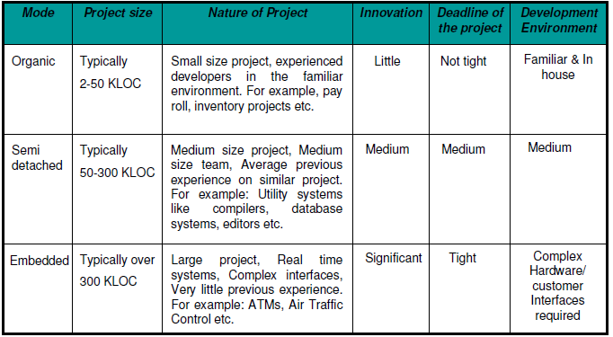
The comparison of three COCOMO modes

Slide 5
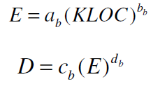
Cost Estimation
Basic Model
Basic COCOMO model takes the form
where E is effort applied in Person-Months, and D is the development time in months. The coefficients a_{b}, b_{b}, c_{b} and d_{b} are given in table 4.

Slide 6
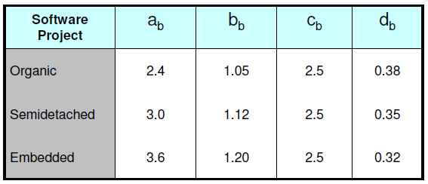
Cost Estimation
Table 4: Basic COCOMO coefficients

Slide 7


Cost Estimation
When effort and development time are known, the average staff size to complete the project may be calculated as:
When project size is known, the productivity level may be calculated as:

Slide 8
Cost Estimation
Example
Suppose that a project was estimated to be 400 KLOC. Calculate the effort and development time for each of the three modes i.e., organic, semidetached and embedded.

Slide 9

Cost Estimation
Solution
The basic COCOMO equation take the form:
Estimated size of the project = 400 KLOC
(i) Organic mode
E = 2.4(400)^{1.05} = 1295.31 PM
D = 2.5(1295.31)^{0.38} = 38.07 M

Slide 10
Cost Estimation
Semidetached mode
E = 3.0(400)^{1.12} = 2462.79 PM
D = 2.5(2462.79)^{0.35} = 38.45 M
Embedded mode
E = 3.6(400)^{1.20} = 4772.81 PM
D = 2.5(4772.8)^{0.32} = 38 M

Slide 11
Cost Estimation
Example:
A project size of 200 KLOC is to be developed. Software
development team has average experience on similar type of
projects. The project schedule is not very tight. Calculate the effort, development time, average staff size and productivity of the project.

Slide 12

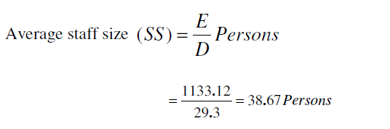
Cost Estimation
The semi-detached mode is the most appropriate mode; keeping in view the size, schedule and experience of the development team.

Slide 13
Cost Estimation

Slide 14
Cost Estimation
Intermediate Model
Cost drivers
Product Attributes
Required s/w reliability (RELY)
Size of application database (DATA)
Complexity of the product (CPLX)
(ii) Hardware Attributes
Run time performance constraints (TIME)
Memory constraints (STORE)
Virtual machine volatility (VIRT)
Turnaround time (TURN)

Slide 15
Cost Estimation
Personal Attributes
Analyst capability
Programmer capability
Application experience
Virtual m/c experience
Programming language experience
Project Attributes
Modern programming practices ()
Use of software tools
Required development Schedule

Slide 16
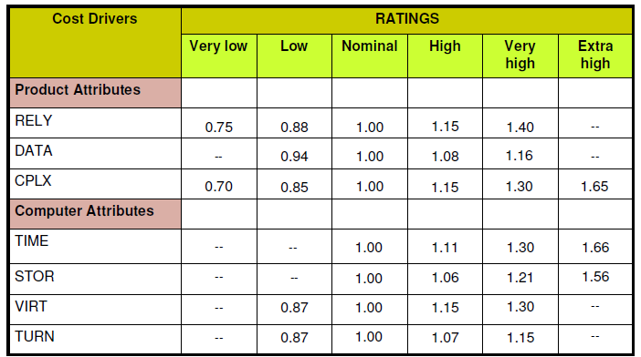
Cost Estimation
Multipliers of different cost drivers

Slide 17
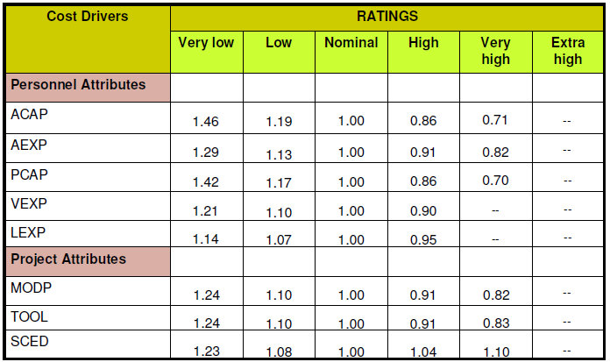
Cost Estimation
Multipliers of different cost drivers

Slide 18

Cost Estimation
The multiplying factors for all 15 cost drivers are multiplied to get the effort adjustment factor (EAF)
Intermediate COCOMO equations
Project | a_{i} | b_{i} | c_{i} | d_{i}
Organic | 3.2 | 1.05 | 2.5 | 0.38
Semidetached | 3.0 | 1.12 | 2.5 | 0.35
Embedded | 2.8 | 1.20 | 2.5 | 0.32
Coefficients for intermediate COCOMO

